Slide 1
Stream API
Operation1
Operation2
Operation3
Java Stream- Intermediate Operations
Create Instance Stream
Terminal Operation
Stream Source
Operation Result
Array, Collection, I/O Resources
Aggregate Result, like Count, Sum or Collecting collection
Stream API-
- Technically Stream is sequence of elements from a source
- Source can be anything like Collections, arrays, generator
functions or I/O resources.
- import java.util.stream

Slide 2
Stream Sources
From a Collection via, stream() and parallelStream() methods
From Array via Arrays.stream(T[])
From static factory methods Stream.of(T[]), IntStream.range(int, int) or Stream.iterate(T, unaryOperator)
Line of a File , BufferedReader.lines();
Streams of random numbers using Random.ints();

Slide 3
Stream Operations
Stream Operations
Intermediate-
Filter()
Map()
Peek()
Sorted()
Distinct()
flatMap()
Skip()
Terminal
forEach()
toArray()
Reduce()
Count()
Collect()
Min()
Max()
Short-Circuiting
Limit()
findFirst()
findAny()

Slide 4
Stream Operations
Intermediate- help to build the stream pipeline to build the execution strategy, lazy operations so they are invokes until any terminal operation is invoked.
Stateless Operations-
Such as filter, map
It will retain a state from the previously visited element when processing the new element – each element can be processed independently of the operation on other elements
Stateful Operations
Distinct, sorted
These operations incorporate the state from previously seen elements when processing the new element.
These operations may need to process the entire input before producing the result.
Terminal Opertions-
traverse the stream and execute the pipeline of operations to produce the result.
They eager in nature
After terminal operation is performed, the stream pipeline is consumed, and can no longer be used.
Intermediate operations or Terminal are short-circuiting operations, when presented with infinite input, it may produce the finite stream as a result.

Slide 5
JPA
Can JPA be used alone without hibernate
No, JPA cannot be used alone. JPA is a specification from Oracle/Sun, and we have to use the implementation from any of the provider. Hibernate, OpenJPA and many providers have implemented this JPA specification. In our tutorials we used Hibernate implementation.
Hibernate has implemented JPA, and along with this, hibernate has its own ORM implementation.
Many organizations are using plain hibernate and hibernate came before JPA. After JPA is released, hibernate has implemented this JPA.
Please remember, if you are using JPA with hibernate implementation, then you should say that you are using JPA not hibernate. I have seen developers who are software architects don’t know the difference between JPA and hibernate.
JPA is a specification and Hibernate is an implementation, also remember Hibernate has its own ORM implementation, means before JPA, many developers and organizations were using hibernate own ORM implementation. So hibernate has two implementation, one is implementation for JPA and second is its own ORM implementation.

Slide 6
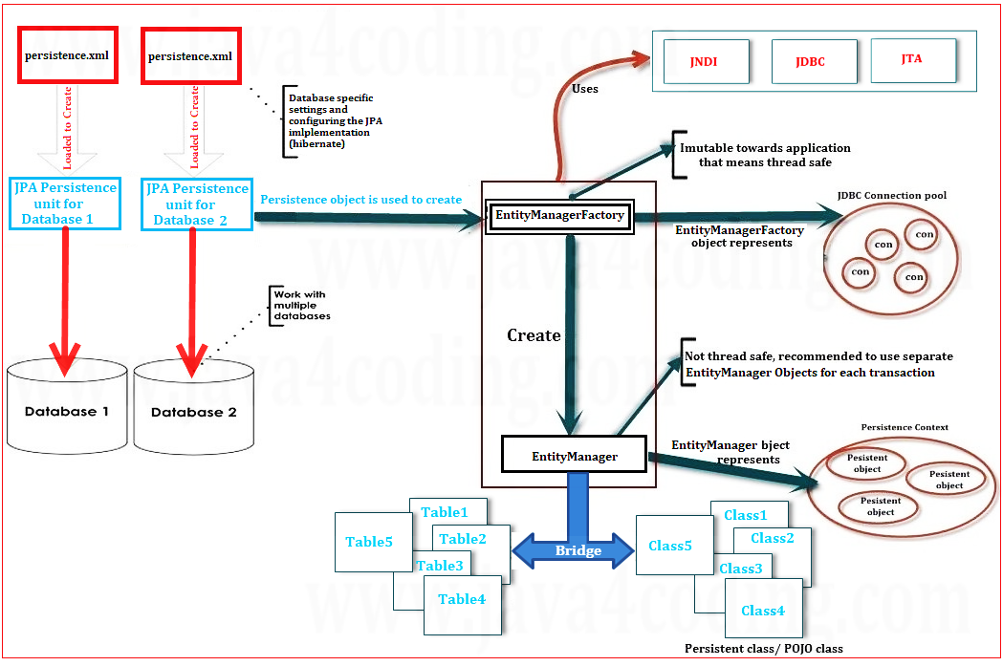

Slide 7
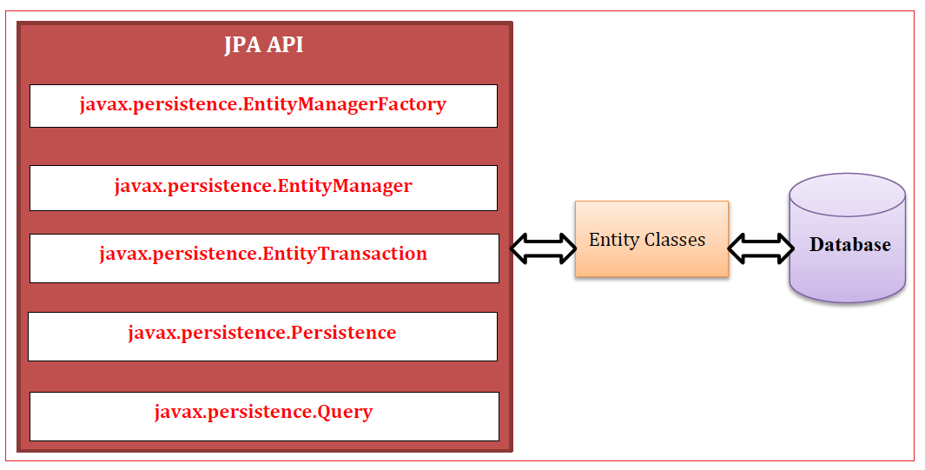

Slide 8
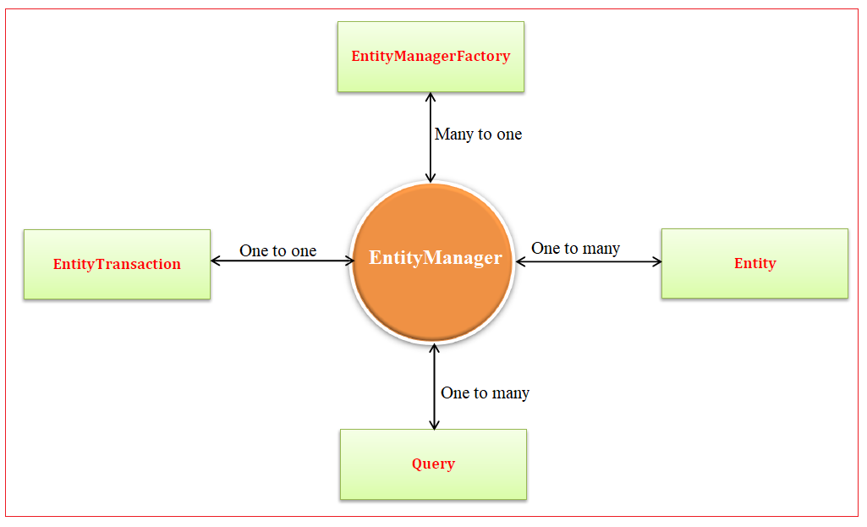
JPA Classes Relationship with EntityManager class

Slide 9
JPA Classes Relationship with EntityManager class
EntityManager with EntityManagerFactory: Many EntityManager can be created from EntityManagerFactory, hence it is many to one relationship.
EntityManager with EntityTransaction: One EntityManager can manage one EntityTransaction, hence it is one to one relationship.
EntityManager with query: One EntityManager can execute many Query objects, hence it is one to many relationship.
EntityManager with Entity: One EntityManager can use many Entity classes, hence it is one to many relationship.

Slide 10
EntityManagerFactory
EntityManagerFactory class is a factory for EntityManagers. EntityManagerFactory object represents the JDBC connection pool. EntityManagerFactory is created by reading persistece.xml and there will be only one object of EntityManagerFactory which will be immutable and also thread safe.
EntityManager
As the name tells, EntityManager manages the entities. EntityManager manages the complete transactions of entities. EntityManager is used to perform CRUD (Create, Read, Update, Delete) operations on entities. EntityManager provides sophisticated methods to perform CRUD operations.
JPA Persistence Unit

Slide 11
JPA Persistence Unit defined inside persistence.xml defines a set of all entity classes that are managed by EntityManager instances in an application.
This set of entity classes represents the data contained within a single data store. The JAR file or directory whose META-INF directory contains persistence.xml is called the root of the persistence unit. The scope of the persistence unit is determined by the persistence unit’s root.
Each persistence unit must be identified with a name that is unique to the persistence unit’s scope. Persistent units can be packaged as part of a WAR or EJB JAR file, or can be packaged as a JAR file that can then be included in a WAR or EAR file.
JPA Entity classes/ Persistent Classes

Slide 12
There should be a java class representing a database table. Such classes are called as Entity classes/ Persistent Classes. Persistence class or an entity class is a POJO (Plain Old Java Object) class, i.e. an ordinary Java class that is annotated with @Entity annotation. Each persistent instance of an entity class - each entity - represents a unique database record. Each variable/field may represent each column of table.
JPA Query
The javax.persistence.Query interface is used to issue queries in JPA. Java Persistence Query Language (JPQL) is the query language used in JPA. The syntax of JPQL is almost same as SQL, but it is object-oriented rather than table oriented. The EntityManager.createQuery method is used to create a Query instance from a given JPQL string. getResultList() method of Query object is used to execute the query. This method returns a List containing the matching entity class objects.

Slide 13
Design Patterns
Intent
Motivation
Structure of Classes
Code Example

Slide 14
Design Patterns
Creational-
Provide the object creation mechanism that increase the flexibility and reuse of existing code
Structural- explain how to assemble the object and classes into larger structure
Behavioral- communication and assignment of responsibilities in between the objects

Slide 15
Creational-
Factory Design Pattern
Builder
Abstract Factory
Prototype
Singleton-
Intent - ensures class has only one instance , while providing the global access to this instance
Solution- make default constructor as private
Create a static creation method that acts as a constructor

Slide 16
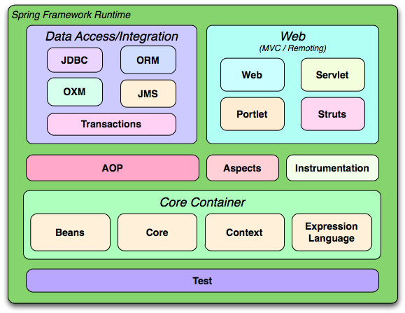
Spring Framework
Spring framework is a Java Platform that provides comprehensive infrastructure support for developing the Java Applications.

Slide 17
Spring -
- Java Platform that provides comprehensive
infrastructure support for developing java APplications
- open source, lighteweight, aspect - oriented loosely coupled, container,
- based java framework
Dependency Injection or IOC
- Using IOC, spring offers creating and inject the required instances
-
Config File(Class Airtel, class Jio)--->object of these classes
getBean()-->get object of the class
IOC COntainer Types-
1. Interface BeanFactory - factory of beans which creates and dispenses the beans
2. Interface ApplicationContext extends the BeanFactory
when we initialize the ApplicationContext, BeanFactory container will get initialise
- types-
1. ClassPathXmlApplicationContext
2. FileSystemXmlApplicationContext
2. XmlWebApplicationContext

Slide 18
Dependency Injection-
1. Setter injection
- <property> tag is used as sub-tag under <bean> tag
- similar to setter method, setter methods and no-arg constructor is required
for setter injection
- only change from <constructor-arg> tag is that index attributed is
supported in <property> tag, rest is same.
- <property> has same sub-tags as :<value>,<bean>, <ref>, <set>, <list>,
<map>,<prop>,<null>
2. Constructor Injection -
- <constructor-arg> can contains name(must be there if index is not used),
index, type(optional) attribute, value or ref(id value of the other beans)
- for below constructor, index 0() zero , refers to id, index 1 refers to name and so on
Employee(int id, String name, String email, EmployeeAddress address)
- <constructor-arg> has <value>,<bean>, <ref>, <set>, <list>,
<map>,<prop>,<null>

Slide 19
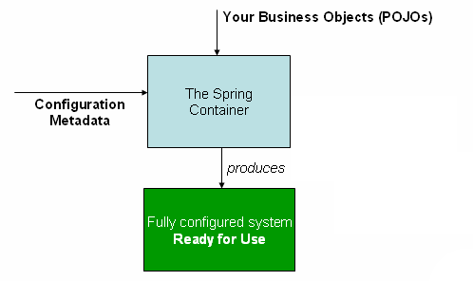
Spring Container

Slide 20
Spring Web MVC
Front Controller
Dispatcher Servlet
Delegate Request
Controller –Handle Request and create a
Incoming Request
model
Return Response
model
Delegate of Rendering Response
Return Control
model
View Resolver / View Temaplate
Web.xml in dynamic web app→all servlet entry
Web.xml/web configuration class-→ only DispatcherServlet
Servlet Class- org.springframework.web.servlet.DispatcherServlet , or take class to impkement WebAPplicationInitializer interface

Slide 21
Spring MVC
DispatcherServlet
DispatcherServlet it expects a WebApplicationContext for its configurations
Servlet WebApplicationContext
(contains controllers, view Resolvers and other web- related beans)
Controllers
ViewResolver
HandlerMapping
Web.xml in dynamic web app→all servlet entry
Web.xml/web configuration class-→ only DispatcherServlet
Delegates if no bean found
Root WebApplicationContext
(contains middle-tier services and datasources, etc.)
Services
Repositories

Slide 22
Spring MVC
Controllers- it will provide you access to the application behavior that you typically define through a service interface.
The controller interprets the user input and transforms that into a model represented to the user by the view.
@Controller – it indicates that the particular class serves as role of controller.
@RequestMapping – used to map URLs onto an entire class or particular handler method.
Typically the class level maps a request to specific path or path pattern onto a form controller.
With additional method-level annotation narrowing the primary path mapping for a specific HTTP method request like GET, POST, etc. Or a HTTP request parameter condition.

Slide 23
HandlerMapping
2
1. Request
DispatcherServlet
Service
(Busimess Logic)
HandlerAdapter
Controller
3
4
5
6
ViewName
Repository
Data Access Layer
ViewResolver
7
8. Response
View
Database

Slide 24
Spring Boot
Spring Framework
HTTP Servers
Spring Boot
XML Configuration
Makes it easy to create standalone, production-grade spring-based applications.
Features-
Create stand-alone spring applications
Embed Tomcat, and Jetty, no need to deploy war files.
Provides opinioned starter ‘dependencies’ to simplify your build configuration
Automatically configure spring and 3rd party libraries
Provides production-ready features, like metrics, health-check, externalized configurations
No requirement for xml file

Slide 25
System Requirements for Spring Boot -V3.2.5
Java 17 and above
Spring Framework 6.1.X
Maven 3.6.3
Tomcat 10.X servlet version 6.0
Starter Dependencies-
These are set of convenient dependency descriptors you can include in your application.
This is one-stop shop for all spring and related technologies
Naming pattern : spring-boot-starter-*, * is type of application

Slide 26
@SpringBootApplication
Equivalent to below three with their default attributes
Com.cg.bank –MainApp (@SpringBootApplication)
Com.cg.bank.pojo-Employee(@Entity)
Com.cg.bank.service(@Service)
@ComponentScan-enable @Component scan on the package where the application is located
@EnableAutoConfiguration- enables spring auto-configuration
@Configuration- allow to register extra beans in the context or import additional configuration clsses

Slide 27
SpringApplication
Can be used to bootstrap and launch the Spring application from Java Main method.
It performs default steps in order bootstrap your application-
Creates an appropriate ApplicationContext instance
Register a CommandLinePropertSource to expose the command arguments as Spring properties.
Refresh the Application and load all the singleton beans
Trigger any commandLineRunner beans.
The constructor arguments passed to the SpringApplication are configuration sources for spring beans.

Slide 28
CommandLineRunner
If you want to access the raw command Line arguments or you need to run some specific code once the SpringApplication has started you can implement that by using the CommandLineRunner interface.
The run(String..args) method will be called on spring beans implementing this interface.
Each SpringAPplication class it will register the shutdown hook with the JVM to ensure that the ApplicationContext is closed gracefully on exit.
@Component
Public class MyBean
{
@Value(“${server.port}
Public String portNo;
}
Java –jar app.jar –portNo=“8085”
Server.port=8085
YAML-
Server:
port: 8085

Slide 29
Tomcat and Jetty have the default port on which they listen to the HTTP request is 8080.
Server.port
Server.address
Server.timeout
We can customize the embedded server properties using java class implementing the interface EmbeddedServletContainerCustomizer, it has customize() method which can implemented in order set customize the server properties, like container.setPort(8085);

Slide 30
Experience APIs
Process APIs- agiility and new value creation
System APIs- primary layer,decentralized access to the core assets
FTP Files
Web services
SaaS apps
Mainframe
Databases

Slide 31
Spring Boot Actuators-
Actuators provides you with all production ready features-
Actuator endpoints let you monitor and interact you with the application
E.g health endpoint- basic health information about the application , accessed by /actuator/health
Beans- provides complete list of all spring beans in application
Caches- expose available cache
Configprops- display configuration properties
Env- properties from Spring’s configurable environment
Info- to show arbitrary application info
Metrics- to show metrics info about app
Shutdown- forcefully shutdown appl, disabled by default
Threaddump- perform thread dump
All other except shutdown are enabled
Com.cg.bankapp.MainApp.java
Com.cg.bankapp.service.UserService.java

Slide 32
 | Spring framework | Spring mvc | Spring Boot
use | Enterprise-level applications | Web application & Restful services | Rapid development & microservices
configuration | Xml files need to configure manually, explicitly | Web-focused, integrated with spring framework | Auto-configuration with sensible defaults
deployment | External servers | Deployed as WAR file in web servers | Standalone jars with embedded with servers
dependencies | Explicitly need to be added | Requires spring core , integrates with spring modules | Starter POM to include sets of dependencies for your common tasks.
 | Is solid foundation suitable enterprise applications and where the fine-grained control over the configuration is required. | Suitable for web applications and RESTful service development within spring ecosystem | Go-to for rapid application development, especially for microservices or when you -want the production-ready application without hassle extensive setup.

Slide 33
Spring Boot Actuators-
Is sub-project from Spring Boot Framework.
You can choose to manage and monitor your application using HTTP endpoints, with JMX or even by remote shell (SSH or Telnet).
Benefit is monitor the health and metrics for production-ready applications.
importing the configuration classes
@Import
@ComponentSCan with @Configuration
Importing XML configuration
@ImportResource
@SpringBootApplication(exclude ={DataSOurceAUtoConfiguration.class})
Class MainApp
{
}

Slide 34
@ControllerAdvice-
Annotated with @Component, means these classes will be registered as spring beans
Applied to all Controllers, we can even applied selectors for using it with specific set of controllers
@RestControllerAdvice-
Annotated with controlleradvice and response body annotations
@ExceptionHandler methods applied after local ones, i.e. from @Controllers.
@ModelAttribute and @InitBinder applied before local ones
@ResponseEntity<T>
It represent whole HTTP Response which includes Status code, header, and body
It has two nested interfaces- HeaderBuilder and BodyBuilder
@ResponseBody-
@ResponseStatus

Slide 35
Application Architecture
Controller
Layer
Service Layer
Dao Layer
Database
JPA/Hibernate
In this case, we are writing a lot of code and repeating the same code for other entities, only the difference is in the type of entity, primary key fields, rest is the same
To avoid boilerplate code, Spring Data JPA can be used.
Spring Data JPA provides repositories so we just need to extend them to get full the out-of-box implantation for CRUD operations of that entity.

Slide 36
Repository
It captures the type of managed entity and the type of entity’s id.
It helps the spring container to discover the concrete repository interfaces during the classpath scanning
CrudRepository
It provides the CRUD operations for the managed entity
ListCrudRepository
extends CrudRepository<T,ID>, Interface for generic CRUD operations on a repository for a specific type. This an extension to CrudRepository returning List instead of Iterable where applicable.
Interface for generic CRUD operations on a repository for a specific type. This an extension to CrudRepository returning List instead of Iterable where applicable.
JpaRepository
this interface is JPA Specific, extension of Respository
It is full of API CrudRepository and PagingAndSortingRepository
PagingAndSortingRepository - Repository fragment to provide methods to retrieve entities using the pagination and sorting abstraction. In many cases this will be combined with CrudRepository or similar or with manually added methods to provide CRUD functionality.

Slide 37
//Repository--->CrudRepository
Product Save(Product p)
Optional<Product> findById(int id);
Iterable findAll()
long count()
void delete(Product p)
boolean existsById(int Id)
void deleteById(ID id);
//many others for CRUD operations
// ----->PagingSortingRepository(Page findall(Pageable),Iterable findAll(Sort))
//JpaRepository -->Repository, CrudRepository, PagingSortingRepository

Slide 38
Spring Data REST- uses the interfaces that extends JpaRepository and provides the CRUD REST APIs for free.
This helps to minimize the boilerplate code of controller layer.
Traditional way, with Spring Based applications
Postman Client
Controller
Service
DAO (Repository)
Database
SpringDataREST
Postman Client
SpringDataREST
DAO (Repository)
Database
https://www.baeldung.com/spring-data-rest-validators

Slide 39
Hazelcast Cache-
This open source in-memory data grid(IMDG) based on Java.
It is a clustered data grid backed up by physical or virtual machines
Caching stores the data that are often used, in temporary memory storage so that you can fetch it quickly.
This help is improving performance and also scalability.
Hazelcast is open source in-memory data grid.
Simple- written in Java
Peer-to-peer : no master no slave, there is no single point of failure. All members are storing equal amount of data , and do equal amount of processing
Scalable- we can scale upto 100-1000 of members.
Hazelcast Cache
Fetch from Cache
Cache Data
Client
Spring Boot App
Database
Request

Slide 40
Need for Hazelcast cache
Server-1
Drawback with this structure is that each time a call will be made to the database.
Whether it is Create, Read, Update And Delete this application makes a call to the Database.
This will be the network call and this will make application slower and cost
JVM
Banking Application
CRUD Operations
Database

Slide 41
Need for Hazelcast cache
Server-1
JVM
Banking Application
In order to overcome drawbacks of previous architecture, we can include cache, that is in-memory data structure like Map.
Key=AccountNo
Value=AccountObject in Cache
So the account details will be stored in the Map and in database as well.
Here is the data in the database is too large then the cache will hold on some relevant data from database based on some algorithms.
Disadvanatges with this approach-
If load increases like multiple users are performing the operations. Here the cache we stored is stored in the memory of JVM. Which has limitations of size.
In order solve this we can use distributed Micro-service architecture.
cache
CRUD Operations
Database

Slide 42
Need for Hazelcast cache
Server-1
Server-2
Server-3
JVM1
JVM2
JVM3
Banking Application1
Banking Application2
Banking Application3
cache1
cache2
cache3
CRUD Operations
CRUD Operations
CRUD Operations
The drawback is data integrity, if app1 has updated or removed some details, it will be reflected in the cache2 and cache3.
Cache2 and cache3 holds the invalid not updated data.
Database

Slide 43
Hazelcast cache
Server-1
Server-2
Server-3
JVM1
JVM2
JVM3
Banking Application1
Banking Application2
Banking Application3
Hazelcast cache
CRUD Operations
CRUD Operations
CRUD Operations
Hazelcast as in-memory distributed cache. It maintains data integrity across all the cache using hazlecast.
Database

Slide 44
Server-1
Server-2
Server-3
JVM1
JVM2
JVM3
Banking Application1
Banking Application2
Banking Application3
Hazelcast cache
H
A
D
G
E
B
G
B
F
I
F
C
C
A
I
H
E
D
Goal of this hazelcast caches to provide high availability of data by keeping it in memory and in a highly distributed fashion.
Clustering-hazelcast cache has clustered set of nodes that work in union.
Distributed-the data in hazelcast is distributed in all the nodes.
Fault-tolerant-it maintains replicated copies of data.

Slide 45
Server-1
Server-2
Server-3
Server-4
JVM1
JVM1
JVM1
JVM1
Banking Application1
Banking Application1
Banking Application1
Banking Application1
Hazelcast cache
A
F
C
G
B
G
E
H
D
I
Application scaling-hazelcast can be scaled horizontally, new nodes can be added to the cluster, and the data in the nodes will get automatically distributed again in all the nodes.
If the Application 4 is added the data that was in previously in node 3 it gets distributed in 4 nodes..

Slide 46
RestTemplate-
Synchronous client perform HTTP requests., used as shared components-
Spring Framework
Request Resource
RestTemplate
REST API
Get Resource
RestTemplate restTemplate;
Employee e=new Employee(101,”John”, “Doe”);
//using postForENtity()
ResponseEntity<Employee> empResponse=restTemplate.postForEntity(“http://localhost:8080/employees”,e,Employee.class);
//with exchange()
HttpHeaders headers= new HttpHeaders();
headers.setBasicAuth(“abc”,”pwd”);
ResponseEntity<Employee> empResponse=restTemplate.exchange(“http://localhost:8080/employees”,HttpMethod.POST,new HttpEntity<e,headers>e,Employee.class);
Exchange()-
To execute the HTTP Method to the given URI
public class Employee
{private int id;
private String firstname;
private String lastname;
}

Slide 47
Kafka-
Kafka is distributed even streaming platform
Event streaming is practice of capturing the data in real-time from event sources like databases, sensors, cloud-service, mobile services, software applications in the form of streams of events, store this events streams durably for later retrievals, manipulating, processing, and reacting to these events streams in real-time and retrospectively. Also routing the event stream to different technologies when required.
Due to this event streaming ensures that continuous flow and interpretation of data so that right information is at right place and at the right time.
Kafka it combine three main capabilities-
1. To publish and subscribe to the streams of events, including import and export of your data from the other systems.
2. To store the streams of events durable and reliably as long as you want.
3. Process the streams of events as they occur or retrospectively.
Publisher/Producer
Message Broker
Consumer

Slide 48
Publisher/Producer
Kafka Cluster
Consumer
Producer 1
Topic 1
Topic 1
Topic 1
Consumer 1
Topic 2
Topic 2
Topic 2
Producer 2
Topic N
Topic N
Topic N
Consumer 2
Partition A
Partition A
Partition A
Partition B
Partition B
Partition B
Partition C
Partition C
Partition C
Producer N
Broker 1
Broker 2
Broker 3
Consumer N
Zookeper

Slide 49
Kafka Cluster
Logs
Topics
- with default retention period as 1 week which is customizable
Purchases
Twitter Tweets
Trucks_gps
Kafka
Consumer 1
Trucks_gps
Consumer 2

Slide 50
Topic A
Event sent and appended to P0
Producer Client 1
Partition 0
ABC 0 | DEF 1 | GHI 2 | JKL 3 | -- -- ---- --- -
ABC 0 | DEF 1 | GHI 2 | JKL 3 | MNO 4 | PQR 5 | -- --- -- --- ---
Producer Client 2
Partition 1
Partition 2
Partition 3
Offset Values

Slide 51
Admin API-
To manage and inspect the brokers, topics and other kafka objects.
Producer API-
Allows application to publish stream of records to one or more topics in the kafka cluster
Consumer API-
Allows application to read streams of data from the topics in the kafka cluster
Stream API-
Allow transforming streams of data from input topics to the output topics
Connect API-
Allows implementing the connectors that continually pull some source system or application into Kafka or the push from the Kafka into some sink system or application.

Slide 52
Kafka Cluster
Topic-
Using topics kafka organize the related messages., each topic is identified by it’s name.
Partitions-
Topics broken down into number of partitions
A single topic it may have mpre than one partition.
logs
purchases
orders
Truck_GPS

Slide 53
Apple
Amazon
Ben
Cat
Confluent
Dog
Partitioner
Test Topic A
Producer
Partition 0
Apple | Confluent
Partition 1
Amazon | Dog
Partition 2
Ben
Partition 3
Cat
Keys are optional, if key is not available kafka will partition the data in round-robin fashion

Slide 54
Messages with same key will go in same partition
K:A, V:Apple
K:A, V: Amazon
K:B, V:Ben
K:C, V:Cat
K:C, V:Confluent
K:D, V:Dog
Partitioner
Test Topic
Producer
Partition 0
Apple | Amazon
Partition 1
Ben
Partition 2
Cat | Confluent
Partition 3
Dog
Key Hashing will be used to determine the mapping of a key to a partition
Default kafka partitioner, the keys are hashed using murmur2 algorithm-
TargetPartition=Math.abs(Utils.murmur2(keyBytes))%(numPartitions-1)

Slide 55
Anatomy Kafka Message
Key-binary
(can be null)
Value-binary
(can be null)
Kafka Message Produces By the Producer
Kafka Cluster
Compression Type-
(none, gzip, lz4, snappy)
Headers(Optional)
Key→Value
Key→Value
Partion +Offset
Timestamp(System or user set)

Slide 56
Consumer Groups
For horizontal scalability purposes, it is recommended to consume the topics group.
Consumers performing same logical job as part of the same application, they can be grouped together as Kafka groups.
Consumer Group App A
Consumer 1
Test Topic
Partition 0
Apple | Amazon
Consumer 2
Partition 1
Ben
Consumer 3
Partition 2
Cat | Confluent
Partition 3
Dog
Consumer Group App
B
Partition 4
Man
Consumer 4
Consumer 5

Slide 57
Polls Topic A
Kafka Broker
Consumer
Producer
Topic A
Every consumer is part of consumer group
A consumer group is the group of consumer instances, that work together to consume the messages from the specified topics.
When the topic is created in kafka, it can have one or more consumer groups associated with it.
The consumer groups maintain the offset information for the partitions they consume.
Test Topic A
Partion 0 | Partion 1 | Partion 3 | Partion 4

Slide 58
Broker, its as single server instance that stires and mnages the partitions.
Kafka cluster, consists of multiple kafka brokers, working together.
Kafka Cluster
Broker 1- Topic A , P0
Producer
Broker 2 – Topic B P0
Consumer
Broker 1- Topic A , P1
Broker 2 – Topic B P1
Broker 2 – Topic B P2

Slide 59
Replication factor - data is not only written to one broker but many
Replication Factor with value as 2-
replica
Broker 2 – Topic B P0
Broker 1- Topic A , P0
Broker 3 – Topic B P0P1(In-Sync Replica)
Broker 2 – Topic A P0P1(In-Sync Replica)
Broker 1- Topic A , P1
Leader
Broker 2 – Topic A P1(In-Sync Replica)

Slide 60
Acks=0
Broker 1
Partion 0 (Leader)
producer
Send message to the leader
Acks=1
Broker 1
Partion 0 (Leader)
producer
Send message to the leader
Respond to every write request
Broker 2
Partion 0 (replica)
2. Send replica
Acks=all
Broker 1
Partion 0 (Leader)
Producer
1. Send message to the leader
3. Acknowledgment to write
4. Respond
3. Acknowledgment to write
Broker 3
Partion 0 (replica)
2. Send replica

Slide 61
Kafka Producer
Producer API
FileSystem
Kafka Cluster
Source Connector
Kafka Broker 1 | Kafka Broker 2
Kafka Broker 3 | Kafka Broker 4
DB
Kafka Streams
FileSystem
Source Connector
Streams API
DB
Kafka Consumer
Consumer API
Connector API

Slide 62
Step 1: Go to the Downloads folder and select the downloaded Binary file.
Step 2: Extract the file and move the extracted folder to the directory where you wish to keep the files.
Step 3: Copy the path of the Kafka folder. Now go to config inside kafka folder and open zookeeper.properties file. Copy the path against the field dataDir and add /zookeeper-data to the path.
dataDir=C:/kafka_2.13-3.1.1/zookeeper-data
Step 4: Now in the same folder config open server.properties and scroll down to log.dirs and paste the path. To the path add /kafka-logs
log.dirs=C:/kafka_2.13-3.1.1/kafka-logs
Step 5: This completes the configuration of zookeeper and kafka server. Now open command prompt and change the directory to the kafka folder. First start zookeeper using the command given below:
.\bin\windows\zookeeper-server-start.bat .\config\zookeeper.properties
Step 6: Now open another command prompt and change the directory to the kafka folder. Run kafka server using the command:
.\bin\windows\kafka-server-start.bat .\config\server.properties

Slide 63
Kafka is distributed even streaming platform
Even streaming- creating and processing in continually real time stream of data
app1
Messaging system
app2
broker
p
Creating/generating real-time stream of data
P
P
Client from paytm
broker
P
P
P
processing real-time stream of data
20- txt limit reach ?
broker

Slide 64
Front end
Database
Hadoop
Security systems
Chat server
Real-time monitoring
Log server
Database

Slide 65
Producer
Consumer
Front end
Database
Hadoop
Security systems
Kafka
broker
Chat server
Real-time monitoring
Log server
Database
Zookeper

Slide 66
Kafka combines three capabilities,
1. publish(write) and subscribe(read) for the streams of event,
2. store, streams of events, durably and reliably for as long as you want
3. to process the streams of events
Kafka
broker
p1
0 | 1 | 2 | 3 | 4
p2
Kafka
broker2
p3
p4
c2
Topic1
Topic2
c1

Slide 67
Consumer grp 1
topic
Consumer1- shipping
P1- payment service
p2
Consumer grp 2
Consumer1- notification

Slide 68
Consumer grp 1
topic
Consumer1- shipping
P1- payment service
p2
Consumer grp 2
Consumer1- notification
Consumer2 notification

Slide 69
Consumer grp 1
topic
Consumer1- shipping
P1- payment service
p2
Consumer grp 2
Consumer1- notification
Consumer2 notification

Slide 70
Monolithic Architecture
Large Development Team
Single code Base
Team 1
User Profile Service
Production
Payment Service
Team 2
User Cart Service
Deployment Pipeline
Team 3
User Management Service
Product Management Service
Team 4

Slide 71
Microservice Architecture
Organized Development Team
Product Team
Product Service
Product Service
Deployment Pipeline
User team
User Service
User Service
Deployment Pipeline
Order Team
Order Service
Order Service
Deployment Pipeline
Payment Team
Payment Service
Payment Service
Deployment Pipeline

Slide 72
Microservies
Microservices- an architectural style that organizes an application as a group of smaller services, instead of a single bulky service
Loosely coupled services,
We can reuse, deployable independently as a single entity
Highly maintainable and testable.
User Profile Service
User Cart Service
Payment Service
User ManagmentService
Product ManagmentService

Slide 73
Architecture Microservice-
API Gateway
Filters
Routing
SSO
Service Discovery & Registry - Eureka
Distributed Logging & Tracing- Sleuth/ Zipkin/ ELK Stack
IOT
MessageBroker – Kafka/RabbitMQ
Microservice 4
Microservice 1
Mobile
Spring Boot Admin UI Actuator
LoadBalancer, Feign Client
Microservice 3
Microservice 2
Spring Data
Browser
Config Server
Gitlab, GitHub
FaultTolerance – Resilience4j
DB
FrontEnd

Slide 74
Netflix Eureka
It’s a service registry that plays central role in automatic detection of different devices and services on a network.
Use to register and discover the microservices.
Microservices will be registered as discovery client
It holds details of microservices running
Service Registry-
It the process of registering the microservices with Eureka Server.
In order to enable the service registry @EnableEurekaServer on the main class of spring boot application
Service Discovery-
Is the process of discovering other microservices in the network to make intra-communication happen.
Eureka server maintains a registry of all the client applications running on different ports and IP addresses

Slide 75
Service Registry & Discovery
Types of Service Discovery-
Client-Side Service Discovery –
Client-side service discovery allows client applications to find services by looking or querying through a service registry, in which the endpoints and service instances are all within the service registry.
Netflix Eureka Server, Zookeeper, Consul
Server-side Service Discovery –
Allows client applications to find the services through a router or load-balancer.
NGINX, AWS ELB

Slide 76
Service Registry & Discovery
Service A- 111.22.33.01:8080
Request
LoadBalancer
Service Registry
Key | Instance List
Service A | 111.22.33.01:8080
Service B | 111.22.34.01:8081 111.22.35.01:8082 111.22.36.01:8083 111.22.37.01:8084
Service B- 111.22.34.01:8081
Query
DiscoveryService
Service B- 111.22.35.01:8082
Service B- 111.22.36.01:8083
Service B- 111.22.37.01:8084

Slide 77
How to create Eureka Server-
1. Create a spring boot project with below depenedency-
<dependency>
<groupId>org.springframework.cloud</groupId>
<artifactId>spring-cloud-starter-netflix-eureka-server</artifactId>
</dependency>
2. Apply the annotation @EnableEurekaServer on mainc lass of your application.
3. Add below properties in application.properties file
#default port no 8761 for Eureka Server
server.port=8761
#by default below property is true, Eureka server itself can'nt be registered
eureka.client.register-with-eureka=false
#Eureka Server will never try to fetch registry as it is itself having a registry
eureka.client.fetch-registry=false

Slide 78
How to register and discover Microservices using Netflix Eureka
1. Create spring Project for microservice with dependency
<dependency>
<groupId>org.springframework.cloud</groupId>
<artifactId>spring-cloud-starter-netflix-eureka-client</artifactId>
</dependency>
2. Add annotation on Main class of microservice application @EnableEurekaClient
3. Modify application.properties file-, along with existing properties.
server.port=8082
eureka.client.service-url.defaultZone=http://localhost:8761/eureka

Slide 79
How to execute -
1. Start the Eureka Server
2. Start the Provider Application
3. Start the consumer application

Slide 80
Open Feign Client-
EurekaServer
@EnableEurekaServer
register
Discover address microservice
register
Student Microservice
@EnableEurekaClient
@FeignClient(name=“address-service”)
Feign Client
Request data
Address Microservice
@EnableEurekaClient
Address Service
Consumer Microservice
Producer Microservice

Slide 81
Feign or Open Feign-
Feign java based declarative rest client.
It simplifies the process of writing the web clients
To use Feign, create an interface and apply the @FeignClient annotation on it.
@FeignClient(name=“address-service”) to define an interface for a consumer
@EnableFeignClients- to apply at starter class

Slide 82
Config Server @ RefreshScope
EurekaServer
@EnableEurekaServer
ConfigServer
Git.uri=….
Git.username=…
Git.password=..
GitHub
Config Client
Actuator
@RefreshScope
Key-value
Key-value
Key-value
Key-value
Key-value
Key-value
Key-value
Key-value
Key-value

Slide 83
What is spring cloud config server-
Spring cloud config is starter project to manage common configurations.
It acts as central configuration server that provides configuration/properties to each microservice connected to it.
@EnableConfigServer annotation to the main class of application to recognize that this application is config server.
Config client-
It utilizes the services provided by the spring cloud config server.
To connect with Config server, we provide the entry of config server in the application.properties file Config client.
External config server-
We use remote repository to accommodate the common config file, like GitHub, GitLab, BitBucket, etc, production environment
Native Config Sever-
Native Config server or Internal Config Server, we use Local system to accommodate the common config file, such as Git,
In development and testing environment

Slide 84
Rest Template-
Synchronous communication,
Client sends request to the service waits for response.
Synchronous communication can be made using RestTemplate or WebClient or Open Feign
Asynchronous Communication- Kafka, RabbitMQ
It is the predefined class in retrieves the Spring Boot Rest Project
Helps in making HTTP calls to the producer application using HTTP methods.
getForObject(URL, some. class) – it retrieves the entity using get method on the given URL, and returns ‘T.class’
It doesn't return the status, header params, only the response body is returned
getForEntity(url, T.class)-
It retrieves the entity by using the HTTP GET method, for the given URL and returns ResponseEntity<T>
Similarly, we have postForObject(URL, T. class) and postForEntity(url, T.class)-

Slide 85
Exchange() method supports any http method-
Exchange(String URL, HttpMethod method, HttpENtity<?> requestEntity, Class<T responseType, object..uriVariables )
Type Parameters:
<T>
Parameters:
url the URL- applications url
method the HTTP method (GET, POST, etc)
requestEntity the entity (headers and/or body) to write to the request (may be null)
responseType the type to convert the response to,
uriVariables the variables to expand in the template
Returns:
the response as entity
Throws:
RestClientException

Slide 86
API Gateway-
Is a single entry and exit point to multiple microservices for an external application/client
Also called an edge microservice.
External clients are restricted from accessing the microservices directly, it acts as a mediator between, external clients and multiple microservices.
Spring cloud gateway works on the Netty server, provided by Spring Boot.
It also provides cross-cutting concerns like, security, monitoring/metrics, resiliency
Why do we need API Gateway?
In microservice-based applications, the different services are generally deployed on different servers/hosts. In this case the client need to remember the port- & and host of the service for the interaction, which is tedious also there are chances of security issues/breach.
Hence , the API gateway validates the authentication , uses its intelligence & routes the client request to the appropriate service to proceses.
Apart from security and routing it helps in monitoring/metrics and resiliency.

Slide 87
API Gateway-
API Gateway
Microservice 1
Gateway Handler Mapping
Post Filter
Client
Request
response
request
Response
Predicate
Pre Filter
response
Microservice 2
request

Slide 88
Advantages of API Gateway-
Routing- the process of identifying the microservice based on predicate(condition) and URL(path) and executing it.
Two types-
1. Static routing-
If a microservice has a single instance( direct call to microservice) the it static routing
In this case API Gateway routes the request directly to the microservice.
2. Dynamic Routing-
When a microservice has multiple instances.
In this case API Gateway reaches Eureka, to get the less load factor instance and then routes the request to the corresponding microservice.
It internally generates the Feign Client code based on the given configuration for load balancing

Slide 89
Resilience4j in Microservices
CircuitBreaker
Bulkhead
Retry
TimeLimiter
RateLimiter- limits the no of requests for a given period
In RestController, with a method in which we have to implement this us @RateLimiter
Properties file-
Result cache
While running microservice based applications, we experience deviations in runtime
And causes for this can be slow response, network failures, REST call failures, failure due high requests.
In order to tolerate these suspected faults, we are using fault tolerance mechanism, like Resilience4j
Resilience4j is lightweight, open-source, easy-to-use fault tolerance Library, inspired by Netflix Hystrix., it designed for Java8 and functional programming.
Resilience4j core modules

Slide 90
RateLimiter- limits the no of requests for a given period
Aop, actuator, and resilience 4j dependencies in
In RestController, with a method in which we have to implement this us @RateLimiter
Properties file-
resilience4j.ratelimiter.instances.getMessageRateLimiter.limit-for-period=2
resilience4j.ratelimiter.instances.getMessageRateLimiter.limit-refresh-period=5s
resilience4j.ratelimiter.instances.getMessageRateLimiter.timeout-duration=0
Here only 2 req are allowed in 5 seconds duration. There is no timeout duration, which means after 5 seconds the user can send the request again.
Add a fallback method

Slide 91
Circuit Breaker-Circuit
1. Closed State-
When a microservice calls the dependent microservice continuously, then circuit is closed state.
2. Open State
Two types-
Count Based (no of req will be considered for failed and timeout)
Time Based (time will be considered for failed and timeout)
Failing Fast
Open
Microservice User
Microservice Product
Microservice Order
Trip Breaker
Trip Breaker
Attempt Reset
Microservice External service
Half Open
Closed
Success
Reset Breaker

Slide 92
Logging & Tracing-
Tracing is the process of finding an execution path or a flow of multiple microservices to serve a request.
Logging is the process of admitting all log messages for a trace. These log messages can be of type, DEBUG, WARN, ERROR, INFO.
Sleuth- it provides the unique ids for the request flow.
Generally it has two ids- traceID and spanID.
TraceID is applicable for complete flow, from traceid developers can find the flow of execution in all microservices
SpanID is applicable for one microservice only, from traceid developers can find the flow of execution in particular microservices.
ParentID- applicable to particular microservice, during the flow of execution span id of previous microservice it becomes parentID of the next microservice
MS 1
spanID=101
MS 2
spanID=102
parentID=101
MS 3
spanID=103
parentID=102
MS 4
spanID=104
parentID=103
TraceID=24998

Slide 93
Zipkin-
Zipkin is used in two parts- Client and server
Zipkin client it contains the Sampler which collects data from microservices with help of Sleuth and provides it to the Zipkin Server.
In order utilize the benefit of we should add Zipkin client and sleuth dependency in our microservice.
Must be only one centralized zipkin server, which will collects the data from zipkin client and display it as UI. Hence the after making request developer should look into Zipikin server to find trace id, span id and flow of execution

Slide 94
Distributed Logging and Tracing using Sleuth & Zipkin
MS 1
MS 2
MS 3
request
response
Sleuth
Zipkin Server User Interface
sampler
Ziopkin Client
Collects & Send

Slide 95
Spring Security-
Spring Security is framework, provides authentication, authorization and protection against common attacks.
Authentication-
It is is how we verify the identity of who is trying to access a particular resource.
Once the authentication is performed then we can perform authorization.
Password Storage-The The PasswordEncoder interface is used to perform a one-way transformation to store password securely.
DelegatingFilterProxy
FilterChainProxy
Filter Chain
DelegatingFilterProxy
client
Bean Filter2
Servlet
Filter 1
Filter 3

Slide 96
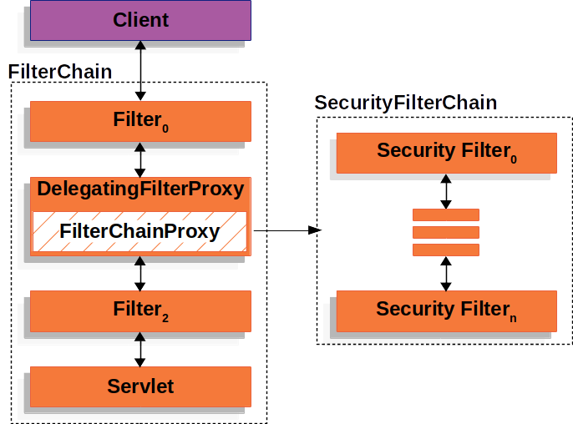

Slide 97
DefaultPasswordEncoder- which ignores below real world problems-
Many applications use old password encodings, that can not be easily migrate
The best practice for password storage will change again
As a framework, spring security can not make the breaking changes frequently.
Instead of this the Spring security introduce the DelegatingPasswordEncoder, which solves the problems by –
Ensuring that the password are encodes using the current password storage recommendations.
Allow for validating in modern and legacy way
Allowing the upgrading for the encoding in future.
DelegatingPasswordEncoder passwordEncoder= PasswordEncoderFactories.createDelegatingPasswordEncoder();

Slide 98
Authorization
Who is allowed to access a particular resource.
http.authorizeHttpRequests((authorize)->authorize.anyRequest().authenticated())
Security context at a minimum be authenticated in order to allow it
UsernamePassword Authentication Token
AuthenticationManager
1
username
password
ProviderManager
2
UsernamePassword Authentication Token
5
UserDetails
Authorities
DaoAuthenticationProvider
3
UserDetailsService
4
PasswordEncoder
DaoAuthenticationProvider

Slide 99
Filters- More than one filter can be used to –
to prevent the downstream filter instances and servlet from being invoked. SO here Filter typically the filter writes the response.
Modify the HttpServletRequest and HttpServletResponse used by the downstream filter instances and the servlet.
Void doFilter(request, response, filetrChain chain)
{
Chain.doFilter(request, response)
}
client
Filter Chain
Filter 1
Filter 2
Filter 3
Filter 4
Servlet

Slide 100
DelegatingFilterProxy
Spring provides the Filter implementation named as DeleagtingFilterProxy, that allows the bridging between the spring lifecycle and ApplicationContext.
client
Filter Chain
Filter 1
DelegatingFilterProxy
BeanFilter
Filter 3
Filter 4
Servlet

Slide 101
FilterChainProxy-
This is the special filter provides by the spring security, delegates to many Filter instances through the securityFilterChain.
Filter Chain
DelegatingFilterProxy
client
FilterChainProxy
Servlet
Filter 1
Filter 3
SecurityFilterChain

Slide 102
Filter Chain
DelegatingFilterProxy
client
FilterChainProxy
Servlet
Filter 1
Filter 3
SecurityFilterChain
SecurityFilter 1
SecurityFilter 2
SecurityFilter N
SecurityFilterChain it used by FIlterChainProxy, to determinewhich Spring security filter instance should be invoked for the current request.
SecurityFilters are nothing but beans, but they registered as they are registered as FilterChainProxy

Slide 103
Filter Chain
DelegatingFilterProxy
client
FilterChainProxy
Servlet
Filter 1
Filter 3
?
SecurityFilterChain 1
SecurityFilterChain N
/api/messages
/api/…
SecurityFilter 1
SecurityFilter 1
SecurityFilter 2
SecurityFilter 2
SecurityFilter 3
SecurityFilter 3
SecurityFilter 4

Slide 104
Protection against Exploits
CSRF-Cross Site Request Forgery attack- spring provides support for protecting against this attack.
Filter Chain
DelegatingFilterProxy
client
FilterChainProxy
Servlet
Filter 1
Filter 3
SecurityFilterChain

Slide 105
@EnableWebSecurity
@Configuration
Class SecurityConfig
{
@Bean
Public SecurityFiletrChain filterchain(HttpSecurity http)
{
}
}
ExceptionTranslationFilter– allows translation of AccessDeniedException and AUthenticationException into HttpResponses
RequestCache-
HttpServletRequest is saved in RequestCache.
When the user is successfully authenticates, then the RequestCache is used to replay the original Request.
SecurityContextHolder- this is where the the spring security stores the details of who is authenticated
Authentication- this interface is present inside the SecurityContextHolder.
Authentication interface serves two main purposes within spring security.
SecurityFilterChain
SecurityFilter 1
SecurityFilter 2
Continue Processing request normally
ExceptionTranslationFilter
SecurityFilter 3
Security Exception
SecurityFilter 3
StartAuthentication
SecurityContextHolder
AccessDenied
RequestCache
AccessDenied
Handler
AuthenticationEntryPoint

Slide 106
OAuth1.0-
It provides a method for clients to access the server resources on behalf of the resource owners.
It also provides the process for end-users to authorize the third party access to their server resources without sharing the credentials.
OAuth2.0-
Open Authentication authorization framework, it enables the third party application to obtain limited access to an Http Service, either on behalf of resource owner by orchestrating some approval interaction between resource owner and http service , or by allowing third party application to obtain access on it’s behalf.
It defines four roles-
Resource Owner
Entity capable of granting access to the protected resource. When Resource owner is a person, it is reffered as end-user.
Resource Server
The server hosting the protected resource, capable of accepting and responding to protected resource requests using access tokens.
Client
The application making protected resource request on behalf of the resource owner and with it’s authorization
Authorization Server
The server issuing the access tokens to the clients after successfully authenticating the resource owner and obtaining the authorization.

Slide 107
Client (Photo editor Application)
A. Authorization Request
Resource Owner
(USER)
Google drive account
B. Authorization Grant
C. Authorization Grant
Authorization Server
Oauth’s main engine That creates the access tokens
D. Access Token
E. Access Token
Resource Server
Google drive
F. Protected Resource

Slide 108
Authentication- it answers the question –Who are you
Authentication is a process of verifying the identity of a user, system , entity
Authorization-
What are you allowed to do?
It allows you to define the access control rules, roles, permissions which are used to control what authenticated users can do and can not do within your application.
API Authorization-
It’s the process that controls the access to the web services or the application programming interface
It ensures that only the authorized users and applications can access the resources exposed by the API.
API-based authorization includes the token based Authentication. e.g OAuth or API Keys
Oauth-Open Authorization- widely used protocol for securing Authorization
Access Token-Random string or digit generated by the authorization server.
Resource- something that is protected from real world due to security reasons.
Resource Owner- is the person, who owns the resource or has full access to it.
Resource server- server which stores the resource.
Client-application that needs access to the resource on behalf of its owner to provide required services.
Authorization Server- server which provides the access token to the client to access resources from the resource server

Slide 109
Client
Document Review Service
Authorization Server
2
Auth Token
5
Auth Token
6
Access Token
7
8. API Call with Access Token
10
3
12
1
9
Resource Server
e.g. OneDriver which contains confidential pages
User
Resource owner
4
11

Slide 110
Oauth-Open Authorization- widely used protocol for securing Authorization
Steps-
1. create a web application using spring boot
2. add dependencies-spring Web, spring security, Oauth and many more as per plan
3. Configure security- defines the user roles and permissions
4. Oauth Configuration-Configure, OAuth2.0 settings, client registration, authorization endpoints, token endpoints
5. implement the user consent- create user interfaces for the resource owner
6. Customize the authorization server behavior according to your requirements
7. secure resources
8. Test and deploy
Authentication Server
Features for spring security includes-
Authentication
Authorization
Access Control
Session Management
Custom Filters
https://developers.google.com/identity/openid-connect/openid-connect
https://spring.io/guides/tutorials/spring-boot-oauth2/

Slide 111
JWT Token
JSON Web Token which is used to transfer information over the web between two parties securely
Can be used for authentication and also for information exchange
Token contains header, payload and signature separated by dots(.)

Slide 112
JWT Authorization
Bearer Authentication Token
AuthenticationManager
1
Token
ProviderManager
2
Jwt Authentication Token
5
Jwt
Authorities
JwtAuthenticationProvider
3
JwtDecoder
4
JwtAuthenticationConverter
JwtAuthenticationProvider

Slide 113
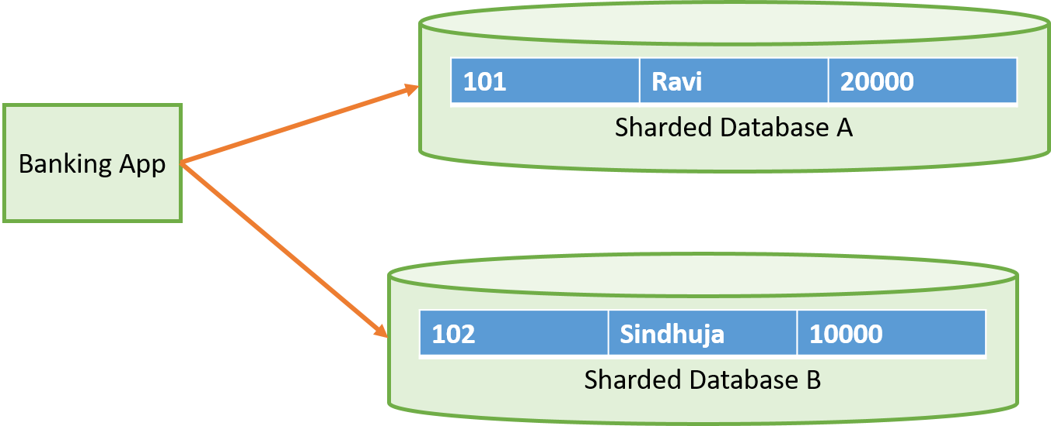
2 Phase Commit(2PC)
Transaction Coorditator- this entity orchestrates commit part of transaction.
Other servers that are managing the individual transactipn are known as participants.
client
Transaction Coorditator
Shard A
Shard B
Begin Credit
Begin Debit

Slide 114
client
Transaction Coorditator
Shard A
Shard B
Begin Credit
Request Commit
Begin Debit
ok
ok
Commit

Slide 115
Event Sourcing
This is an architectural design pattern synchronously receive and asynchronously distribute the data/ events within an architecture.
Only create , read and delete operations are allowed to perfomed

Slide 116
Summarizer
Update/ Create
Read
DA
Event sourcing system
SA
Create/ Insert
Client S1
Dumb Bus
subscribe
Propagator
pubish
subscribe
Client SN

Slide 117
CQRS(Command Query Responsibility Seggregation)
Focus is on to separate the way of reading and writing the data
Two models it contains-
Queries – reading the data
Commands – writing data, changing state(insert, update, delete)
Storage
UI
Command service
[Command Model]
WRITES
Query service
[Query Model]
READS

Slide 118
CQRS(Command Query Responsibility Seggregation)
UI
Command service
[Command Model]
WRITES
Sync
Query service
[Query Model]
READS

Slide 119
Saga Pattern
Manage the transactions that span across multiple microservices using Sequence of local transactions
Saga Execution Controller(SEC)-it tracks all the events of distributed transactions as a sequence and decides the rollback events in case of a failure.
SEC internally uses the Saga log to keep track of all transactions
Saga Execution Controller-

Slide 120
Saga Pattern
Implementations:
Orchestration –
In this a single orchestrator/arranger manages all the transactions and directs the services to execute local transactions
Orchestrator acts as a centralized controller of the local transactions and maintains the status of the complete transaction.
Suggested for scenarios when you have already implemented microservices and when a large number of microservices participate in a single transaction
Choregraphy-
In this all the services that are part of the distributed transaction publish a new event after completing their local transaction
Suggested for scenarios when you implement microservice from scratch, and when a small number of microservices participate in single transaction

Slide 121
Booking Service
Payment Service
Seat Updating Service
Notification Service
Customer request for booking
Process the Payment
success
Update the seat availability
End
Send notification to the customer
reject
Cancel Booking
Reverse the Process the Payment
Reverse the Update seat availability
Cancel Booking Confirmation
Orchestration-Based Saga

Slide 122
Booking Service
Payment Service
Seat Updating Service
Notification Service
Customer request for booking
Process The Payment
Update the seat availability
Send the Confirmation
Start T1
End T1
Start T2
End T2
Start T3
End T3
Start T4
End T4
Saga Execution Controller(SEC)
Start the Booking Process
End the Booking Process
Saga Log
Choregraphy-Based Saga

Slide 123
Booking Service
Payment Service
Seat Updating Service
Notification Service
Customer request for booking
Process The Payment
Update the seat availability
Send the Confirmation
Start T1
End T1
Start T2
End T2
Start T3
Fail T3
End the Booking Process
Saga Execution Controller(SEC)
Start the Booking Process
Saga Log
Choregraphy-Based Saga

Slide 125
DevSecOps
In development, security focuses on to identifying and preventing the vulnerabilities, and in operations, monitoring and defending against the attacks are the main objectives.

